Slide 1
Football Match Prediction
Team - 11
David Haiming Wang, Deepika Mehanti, Geon Woo Andy Jeong, Xuan Liu(Kate)

Slide 2
Introduction
It is true that football is gaining popularity because of the excitement and thrill that it offers. Most of us being football lover , we all have our favourite team and always excited to see them win. Thinking about betting, we clearly can see that football is a very unpredictable sport, and it does not acquire serious research to prove that. As a Data Analyst we thought of making a Football Match Predictor for over Stakeholders and for everyone who love to see what is going to the result of upcoming season.
Although, you can find some individuals who are genuinely good when it comes to a football prediction. They are capable to predict what will transpire inside match. So, the prior objective of this project is to create a supervised machine learning algorithm that predicts the football matches results based on the statistics of the matches. Thus it will be possible to evaluate the difficulty level of prediction.

Slide 3


Research Questions
Who is going to win the next season?

Slide 4
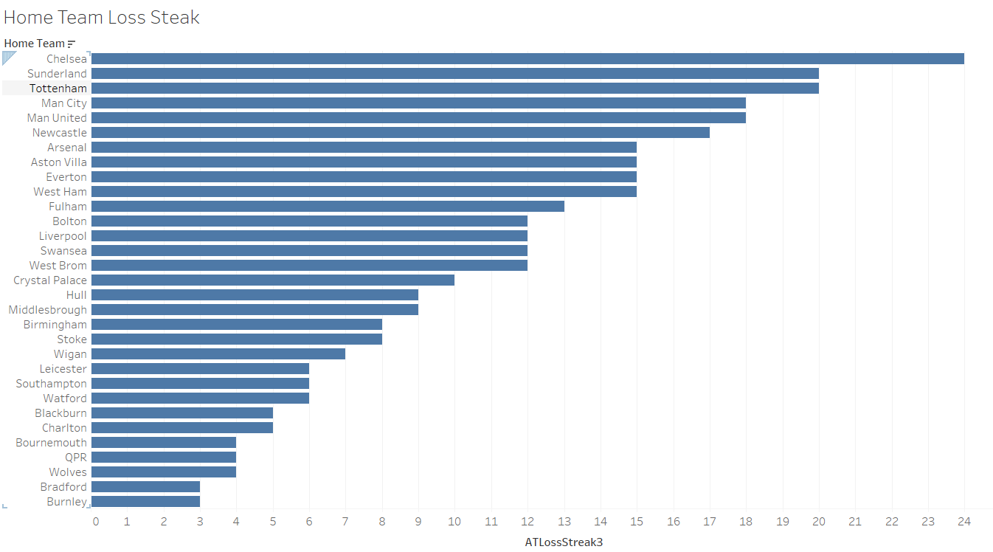
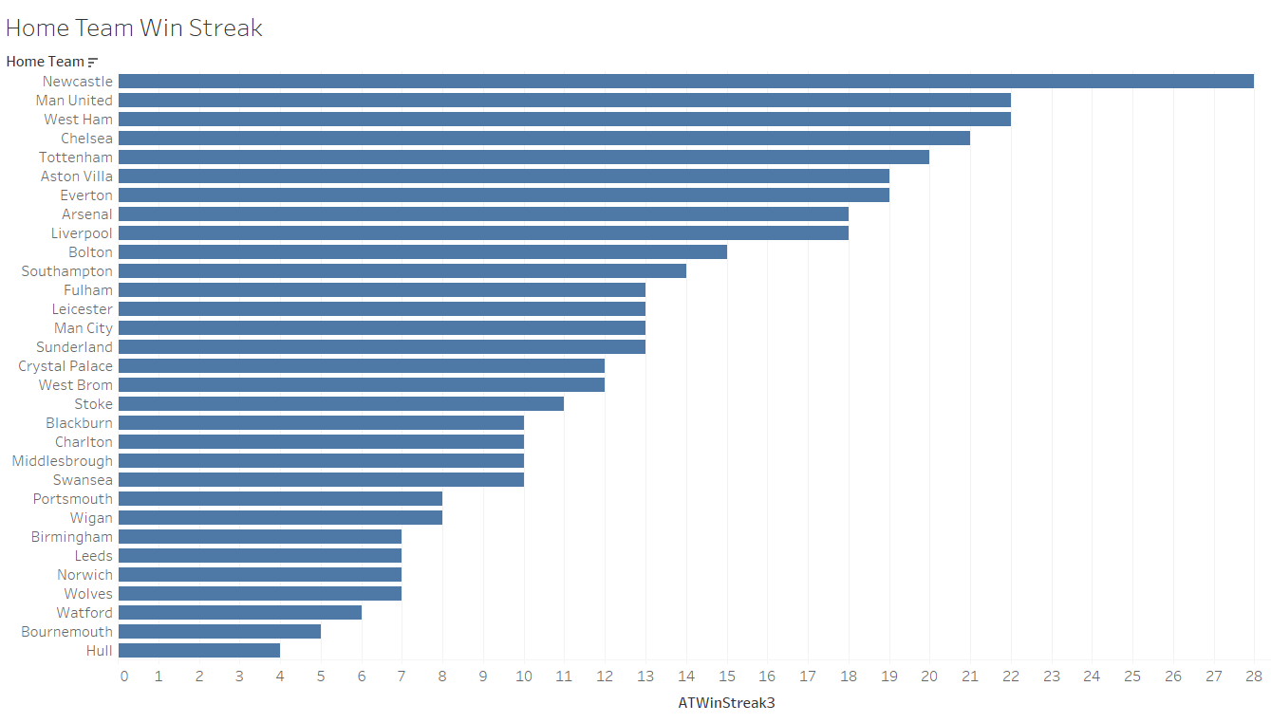
Home Team Win and Loss Steak
Chelsea
New Castle

Slide 5
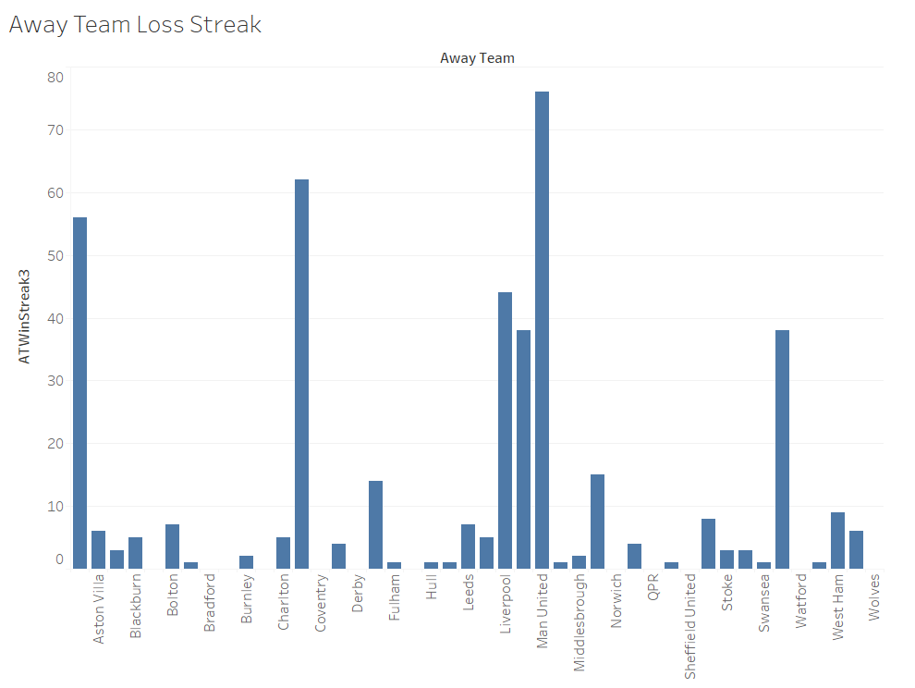
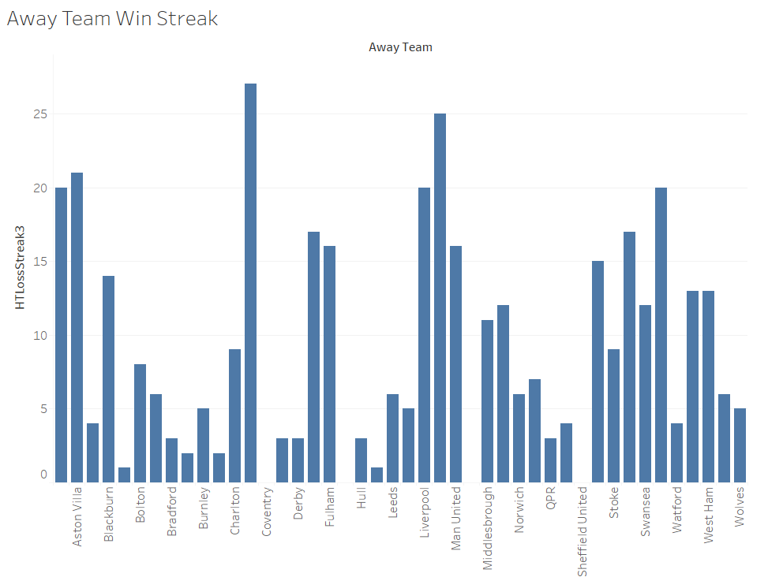
Away Team Win and Loss Steak
Man United
Chelsea

Slide 6
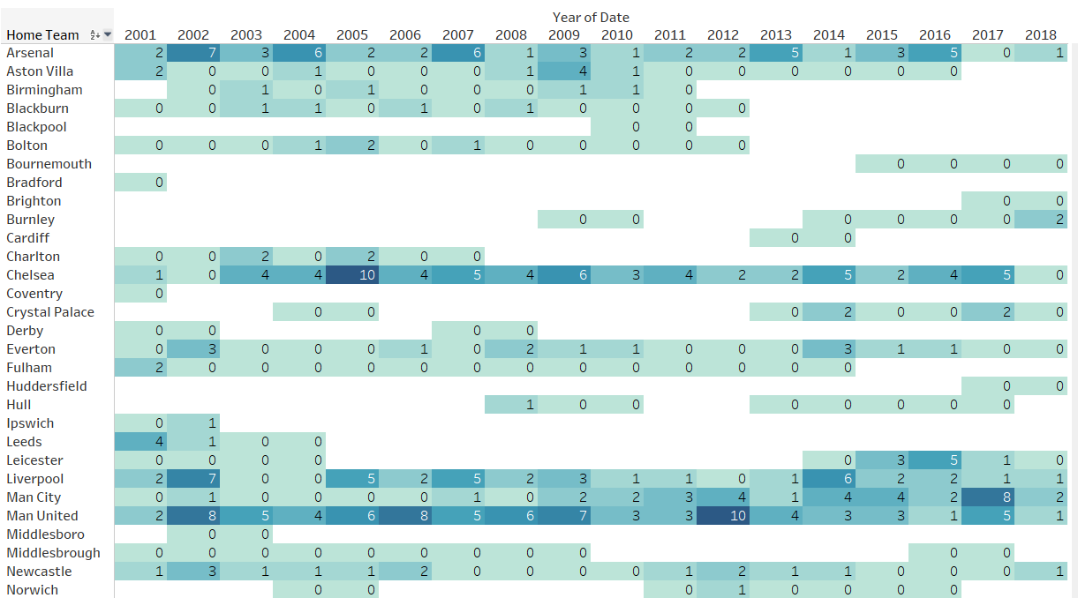
Home Team Win Steak From Year 2001-2018

Slide 7
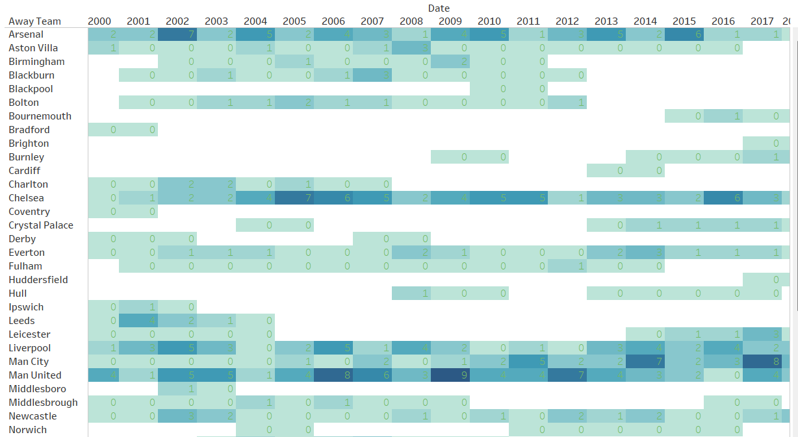
Away Team Win Steak From Year 2001-2018

Slide 8
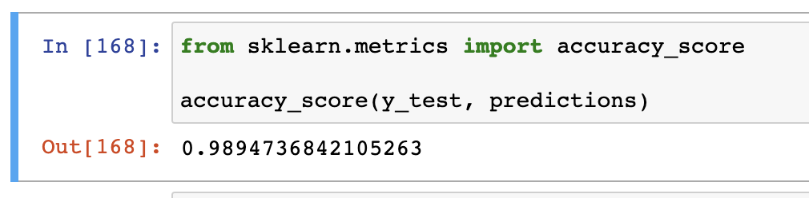
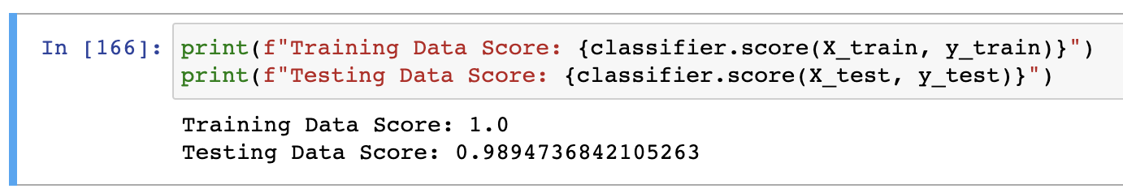
Logistic Regression – 1st Model
For my first attempt, I tried predicting the winner (home vs. away) using logistic regression. Logistic regression is used because of its accuracy and usefulness in solving categorical issues.
However, my scores were too good to be true. The initial accuracy score test gave 1.0, which only decreased marginally after the second attempt.

Slide 9
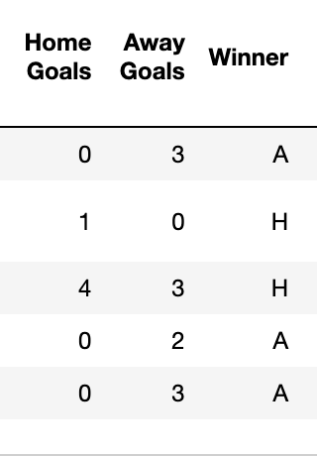
Troubleshooting 1st Model
The very thought of predicting which side (home vs. away) won was a bad mistake in the first place. Data contained exact scores of each side, which explained the obviously perfect accuracy rate.

Slide 10
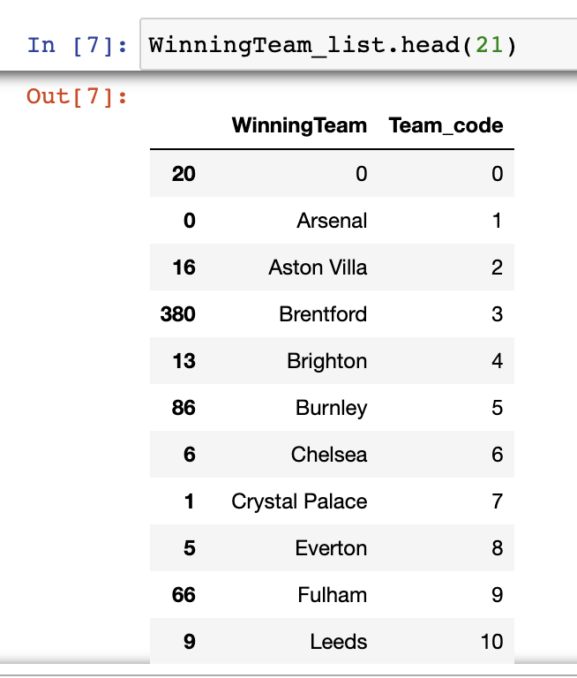
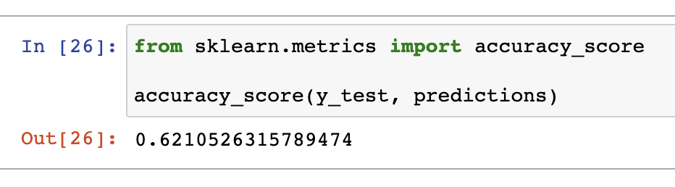
Logistic Regression – 2nd Model
For my second attempt, I made a new column, listing the names of the team that won each game, which were numerically codified after. The model was run again, resulting in the accuracy score of 0.62.

Slide 11
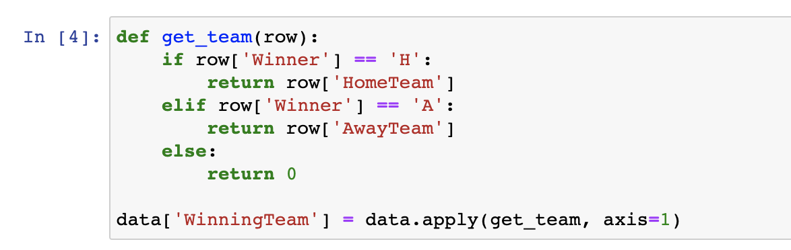
Improving 2nd Model
I doubled the amount of data by adding an additional dataset from another season. The prediction was made using 20/21 - 21/22 data, as opposed to just one season.
I also added new columns to suit the main purpose of the prediction – to see who will win this year’s league!

Slide 12
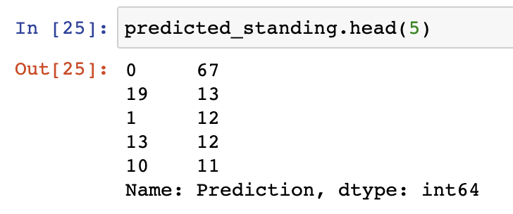

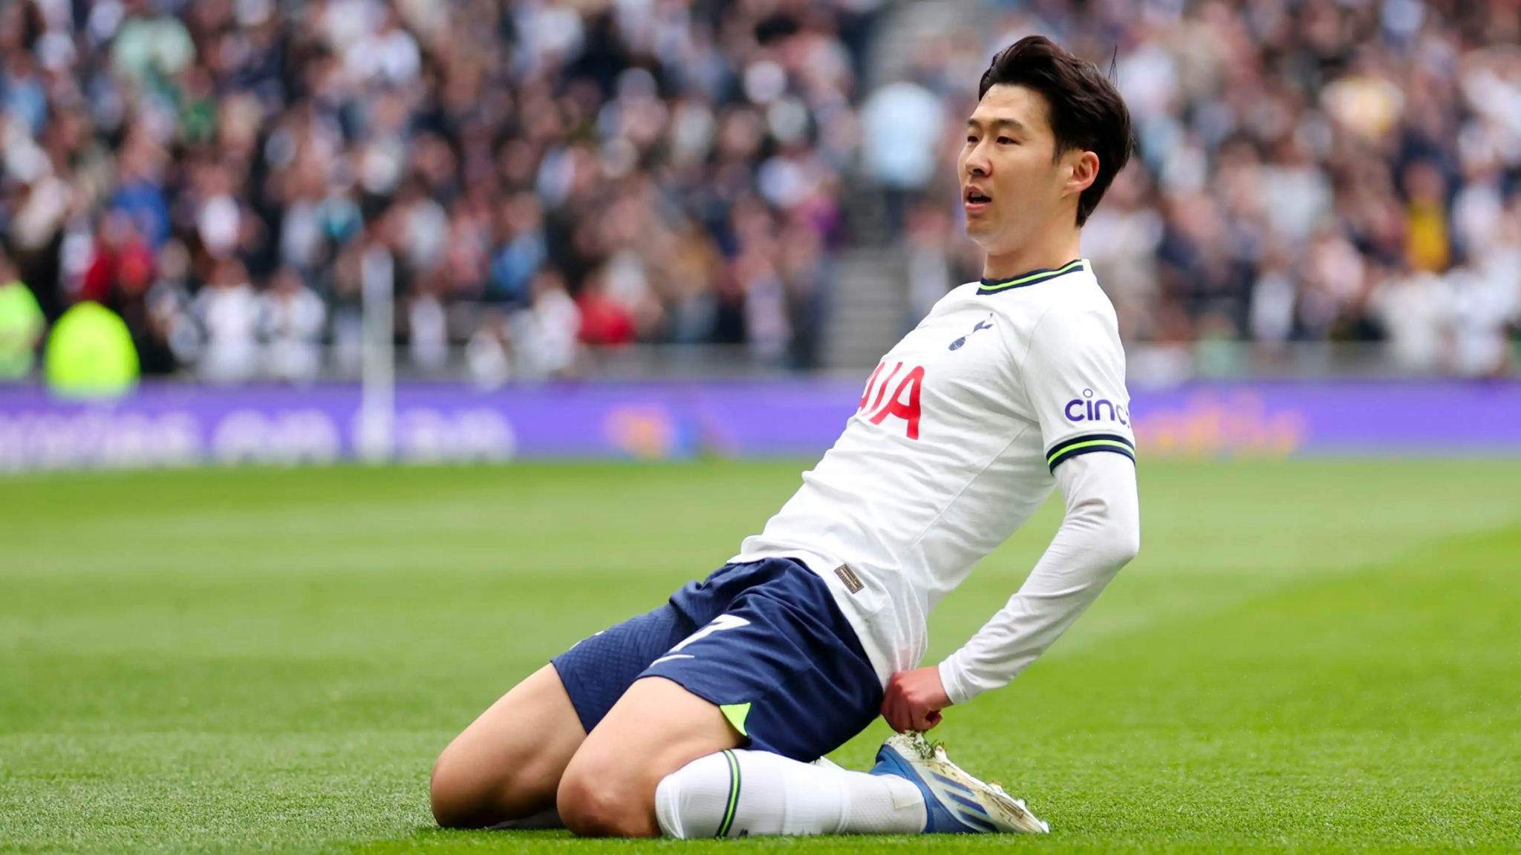
Logistic Regression – Results
0 is the number of draws in the tested data, so ignore it.
Finally, my model predicted that Team 19 – Tottenham Hotspurs – would win the league (most n of wins), followed by Arsenal (1), Man City (13), and Chelsea (10).
Tottenham has 62% chance of winning the league cup, according to my model. Will they be able to win their first ever trophy?
If i trust my model, I would have to bet on Tottenham.

Slide 13
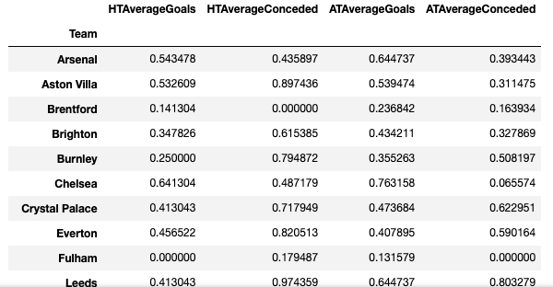
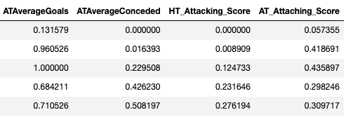
Random Forest Model Approach 1 (David)
Data Source: 2020-2021 EPL Season Fixtures.
Create a column with a calculated attaching/offensive rating, rating generated from goals scored and goals conceded for home team and away team.
The model was able to generated a predicted points table ranking for the next season based on the data we gathered.

Slide 14
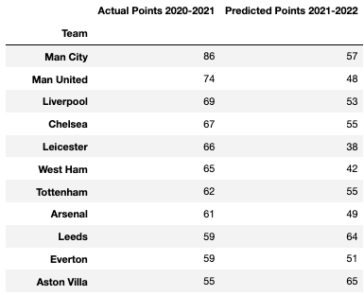
Random Forest Model Approach 1 (David)
Initial model has low accuracy (< 75%), added data from another season and the accuracy did not improve.
The generated prediction predicts Sheffield United to be the winner.

Slide 15

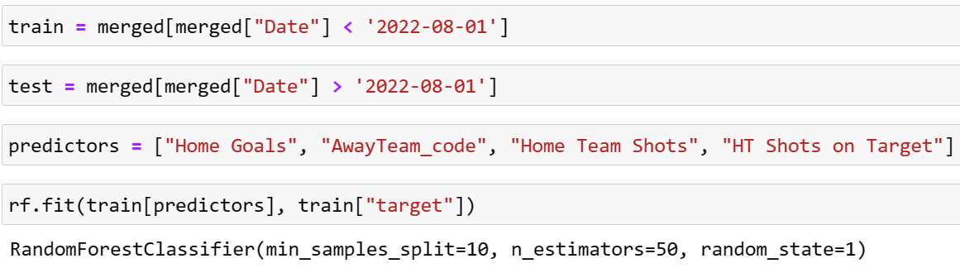
Random Forest Model Approach 2 (Kate)
Data contains 2020 -2022 two seasons of Premier League (760 record)
Use parameters before 2022-08-01 as train and after 2022-08-01 as test
Four predictors - accuracy rate = 90.7%
Notes:
setting the minimum sample split parameter too high can lead to underfitting, as the model may not be able to capture enough details of the data. On the other hand, setting it too low can lead to overfitting, where the model may become too complex and not generalize well to new data

Slide 16
Conclusion
This project evaluated football results prediction for the English Premier League using various machine learning models based on real-world data from the real matches. The models were tested recursively and average predictive results were compared. The results showed that logistic regression yielded somewhat reasonable results, but falling short of the desired accuracy rate by about 13% (62.1% compared to 75%).
In addition, a ranking of the features’ relative importance was made to orient the use of Data.

Slide 17
Data sources
● https://github.com/awesomedata/awesome-public-datasets
●https://www.kaggle.com/datasets/martj42/international-football-results-from-1872-to-2017
● https://www.kaggle.com/datasets/secareanualin/football-eve
https://www.todaymatchprediction.com/
https://github.com/topics/football-prediction
https://public.tableau.com/app/discover
https://fbref.com/en/comps/9/Premier-League-Stats

Slide 18
Questions?
THANK YOU!!

